Slide 1
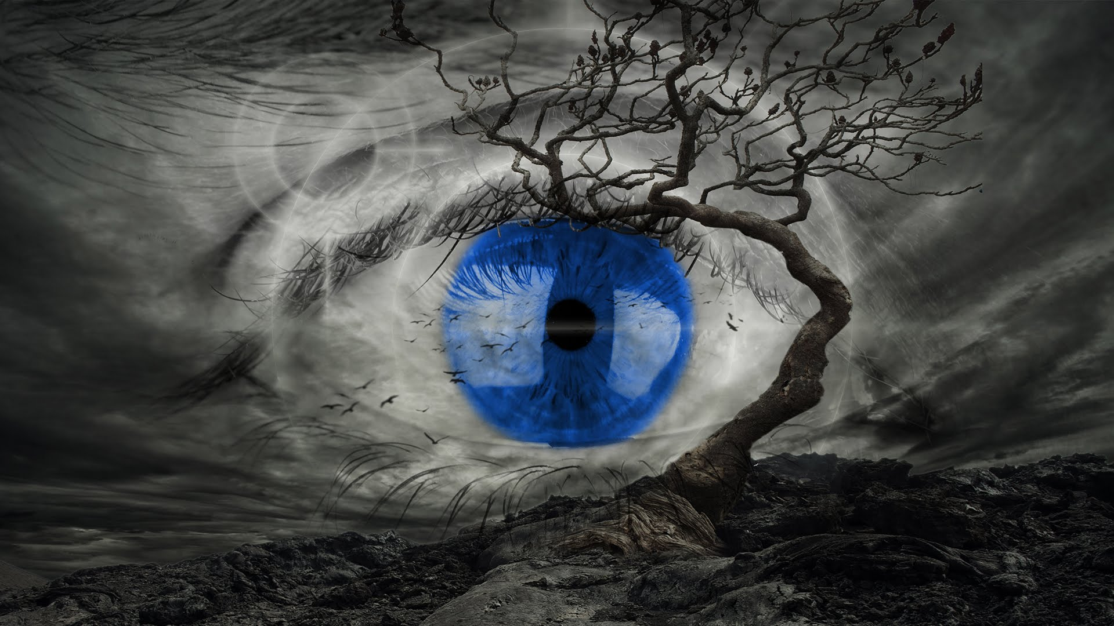
Visions – Often the simplest way to tell a story is a picture by Ralf Martin (r.martin@imperial.ac.uk)

Slide 2
Plan for this lecture
The good, the bad, the ugly and how to make things better
Good data visualisations are a great way of telling a story
Let’s look at some examples
Let’s learn some R commands for visualisations
Let’s try to make some new visualisations
In part based on lecture notes by Richard Davies

Slide 3
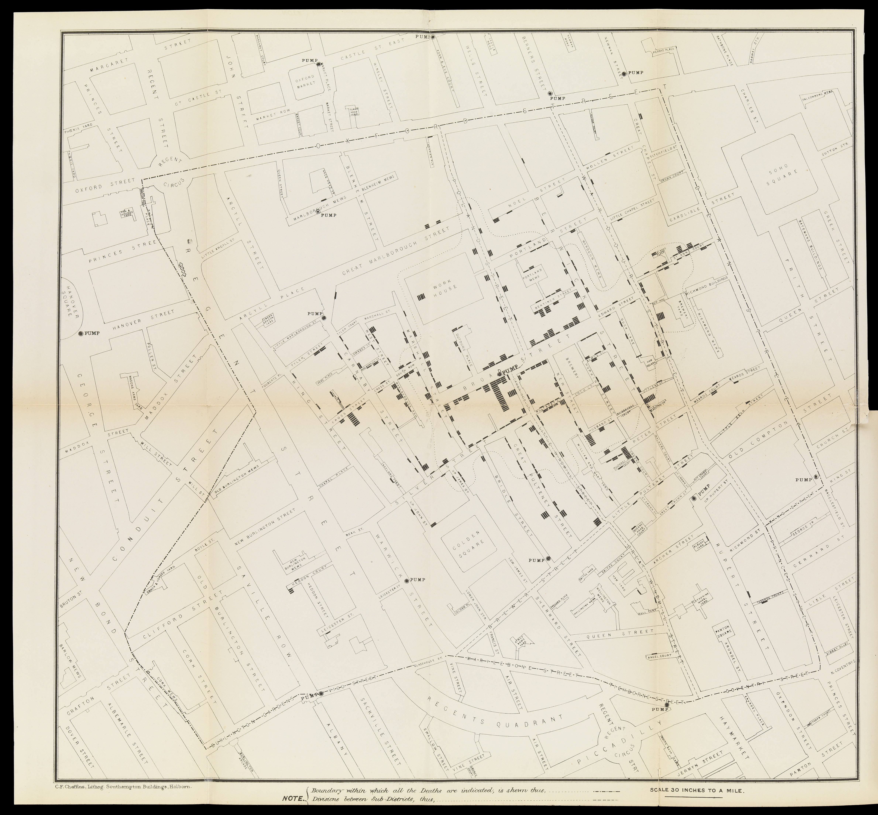
One of the greatest data story visualisations of all time:
John Snow tracing Soho Cholera outbreak
Correctly identified contaminated water as reason for decease
Convinced people with this figure
Changed city planning and sanitation
More here

Slide 4
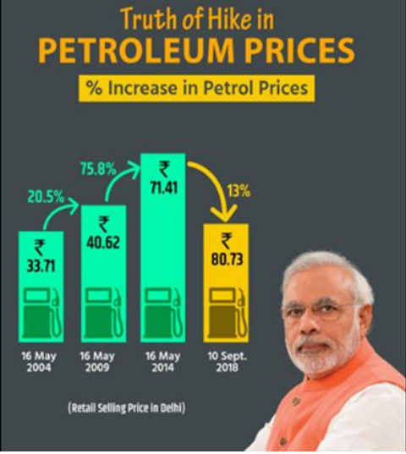
The bad - What can go wrong?
Deliberate misleading
Pretending prices have come down when they haven’t
More here

Slide 5
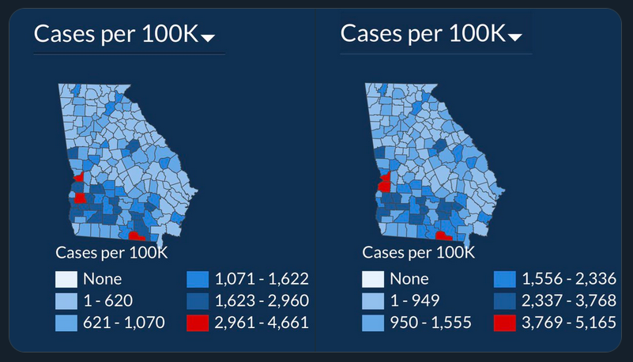
The bad - What can go wrong?
From the US State of Georgia
July 2
July 17
Deliberate misleading
Incompetence
Figure seems to tell the story that COVID situation hasn’t changed much (when it has)
More here

Slide 6
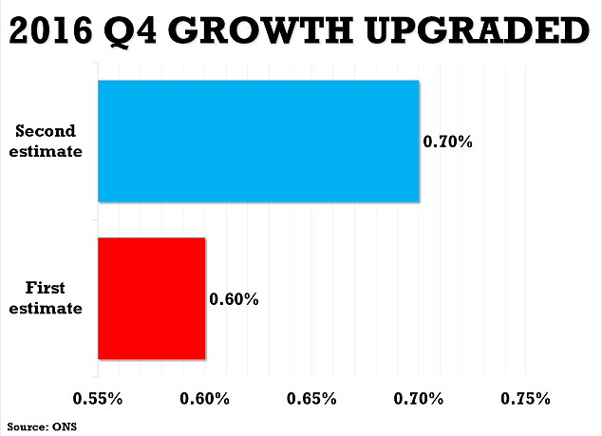
The bad - What can go wrong?
Deliberately misleading
Pretending that something is a bigger deal (when it isn’t)

Slide 7
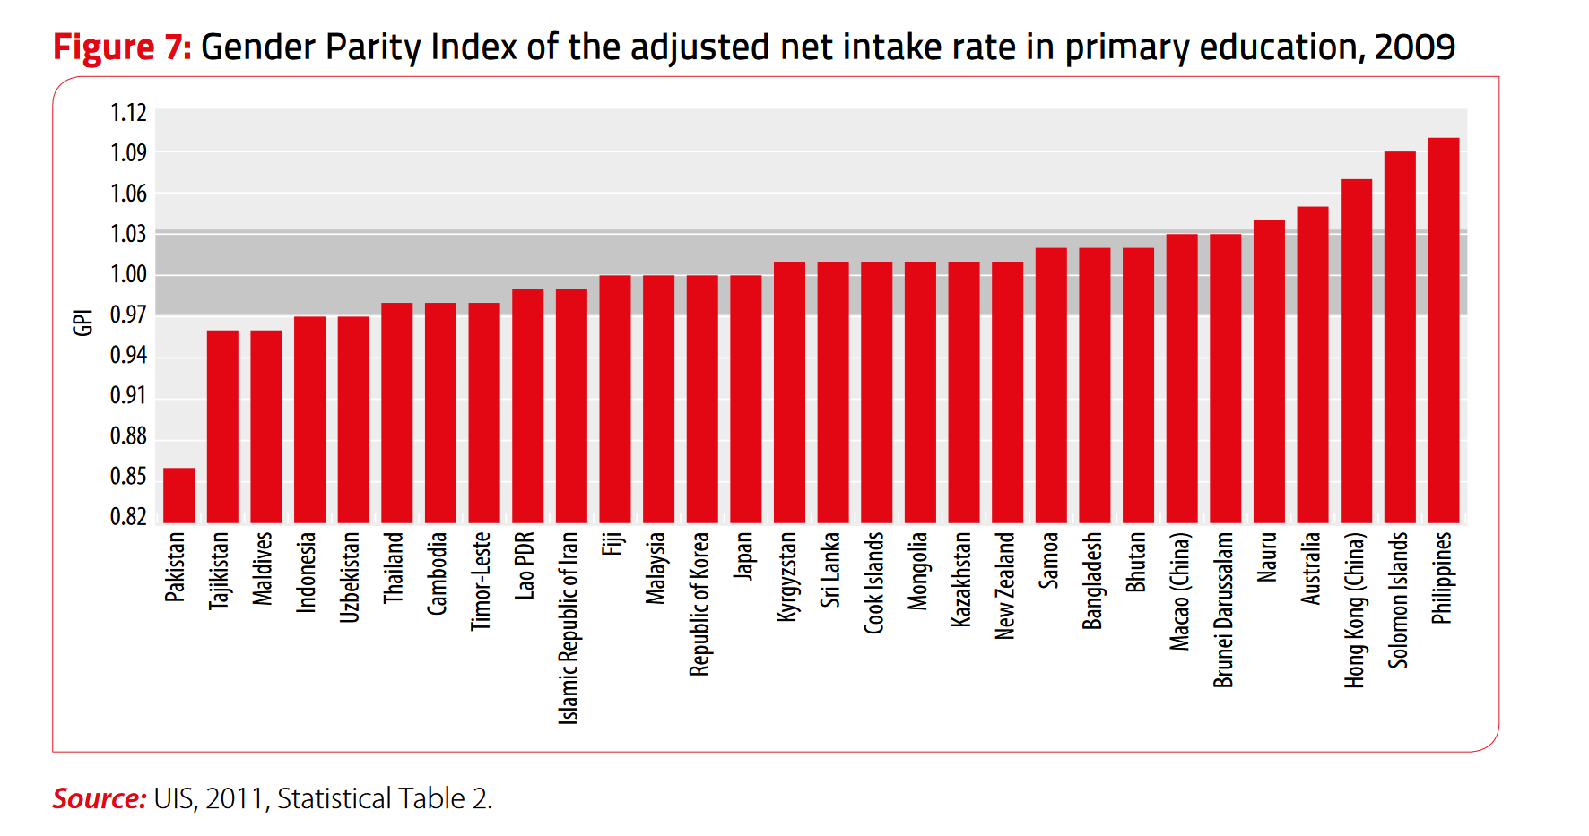
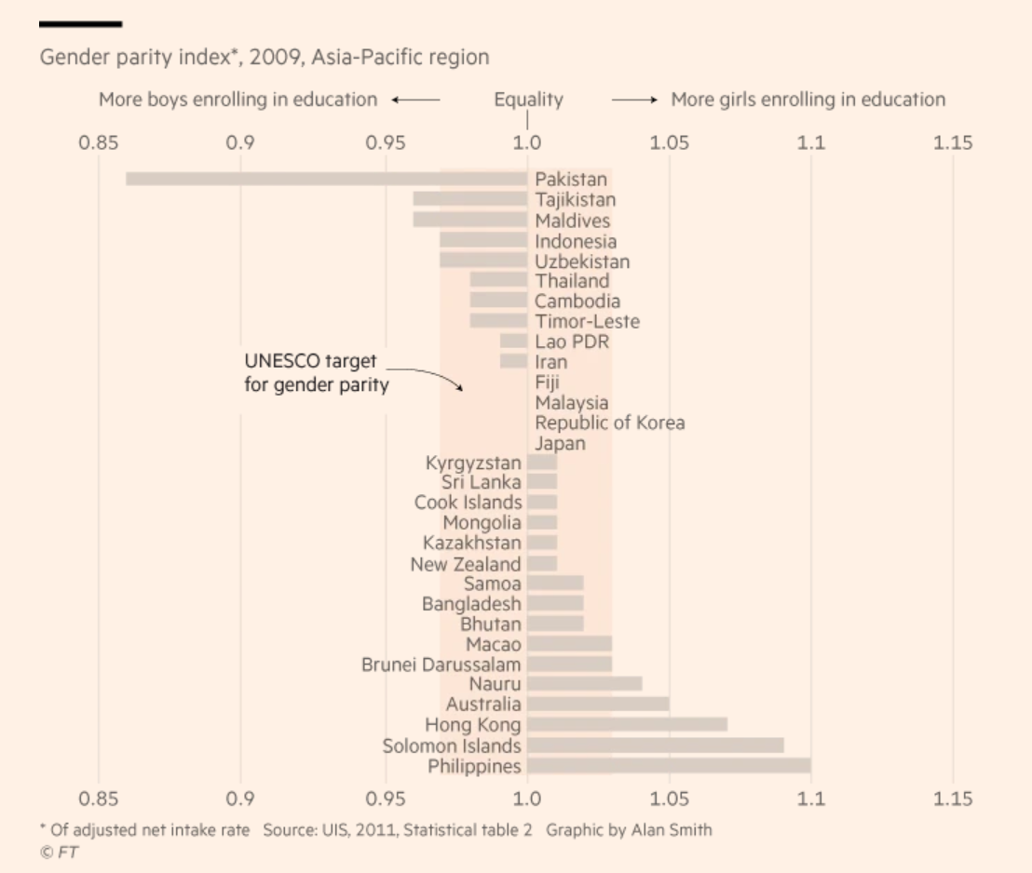
The bad – What can go wrong?
Looks like the Philippines are doing best?
This might be a better way (more discussion here)

Slide 8
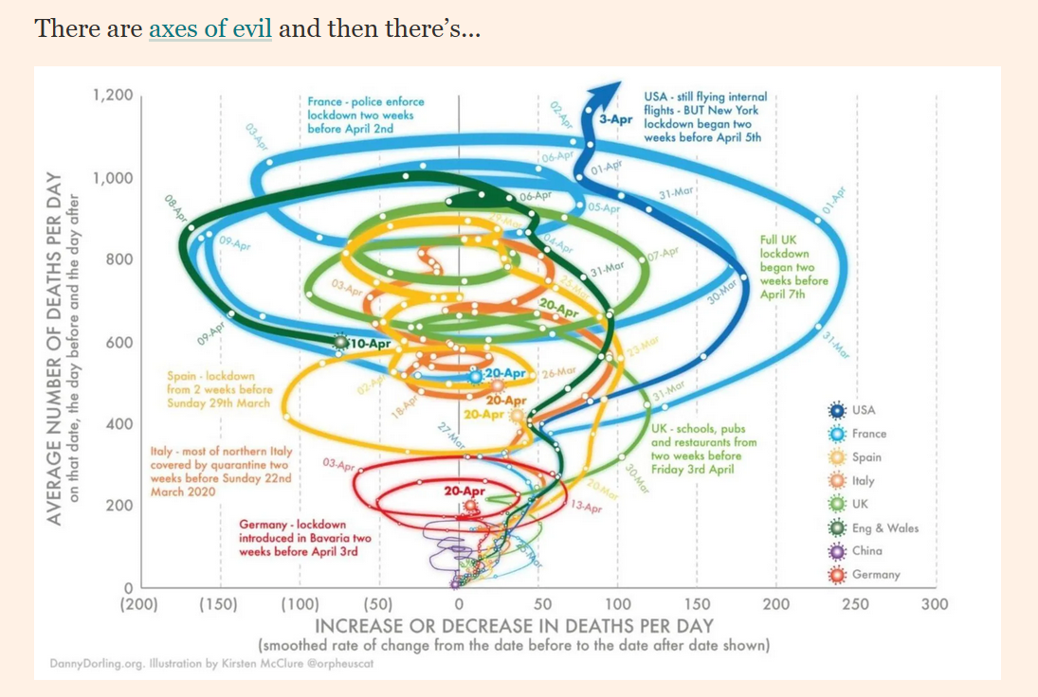
The bad – What can go wrong?
Looks kind of cool but what does it tell us?
For many more examples consult the FT’s chart doctor

Slide 9
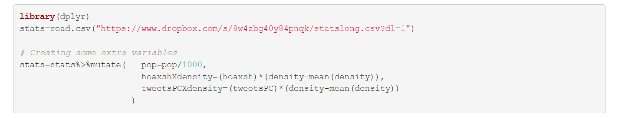
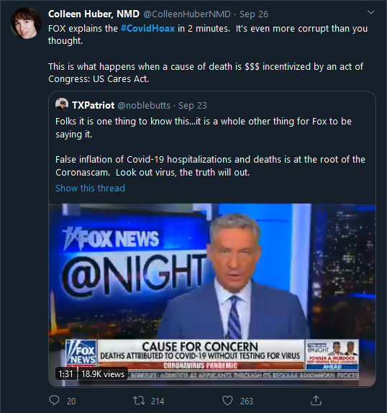
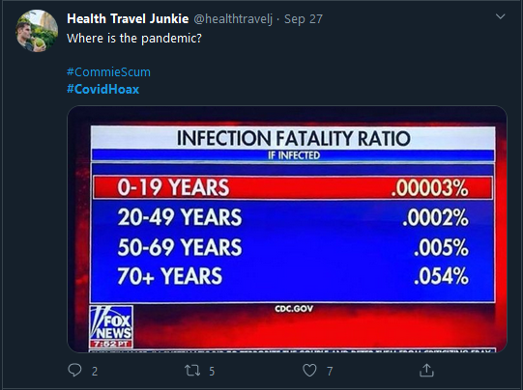
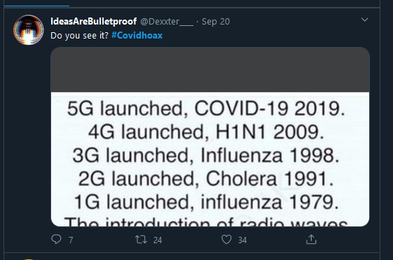
R visuals – Let’s get some data for examples
Data on COVID hoaxism
Rmd file with code for this lecture
html file

Slide 10
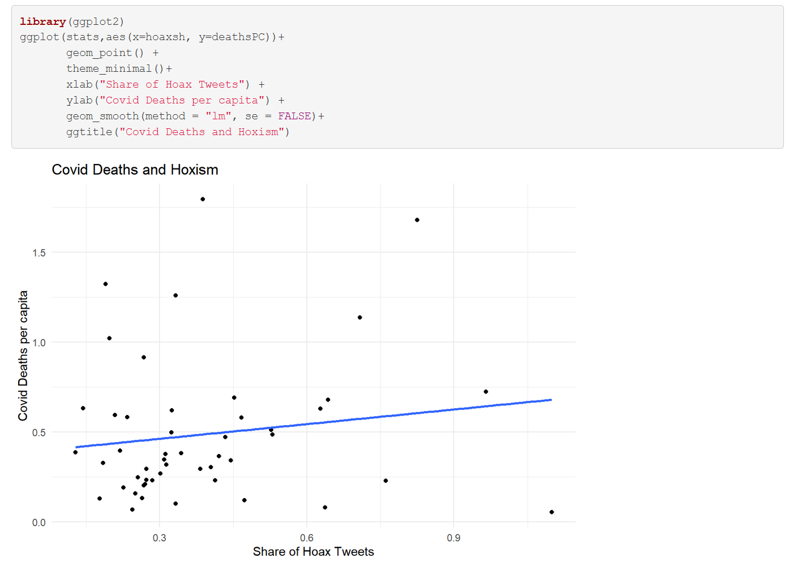
Scatter ggplot– The relationship between COVID hoaxism and deaths

Slide 11
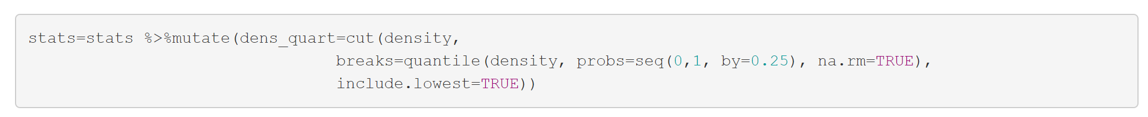
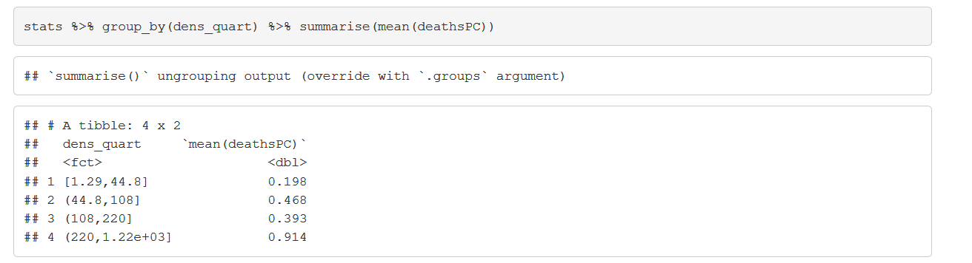
Adding twists to your scatter plot story
If hoaxism causes deaths we might expect this to be worse in more densely populated regions
Creating quartile bins of the population density variables

Slide 12
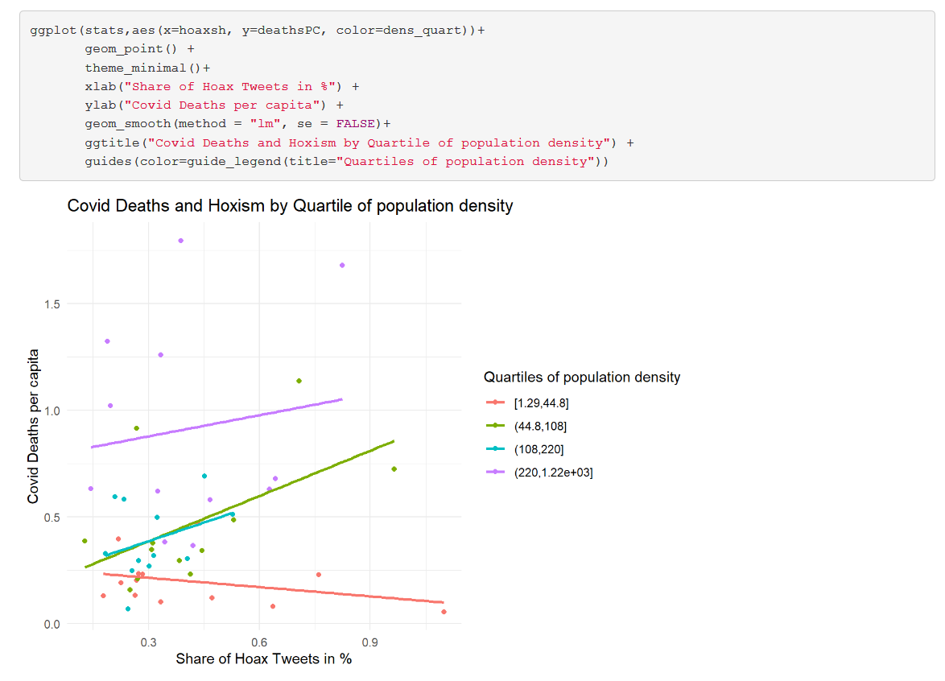
A lot more story with very little more code
That’s all

Slide 13
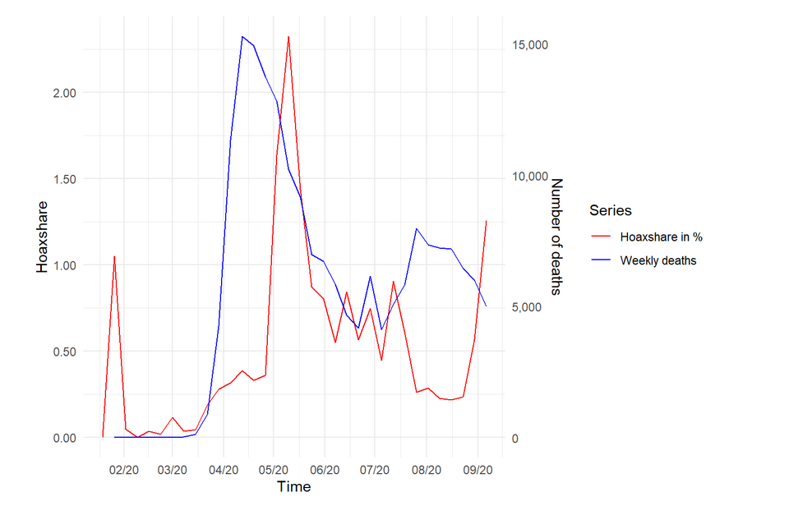
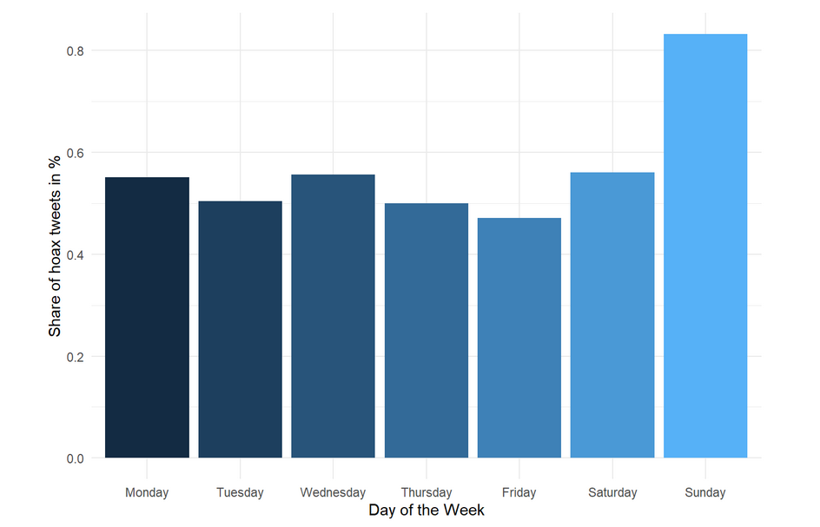
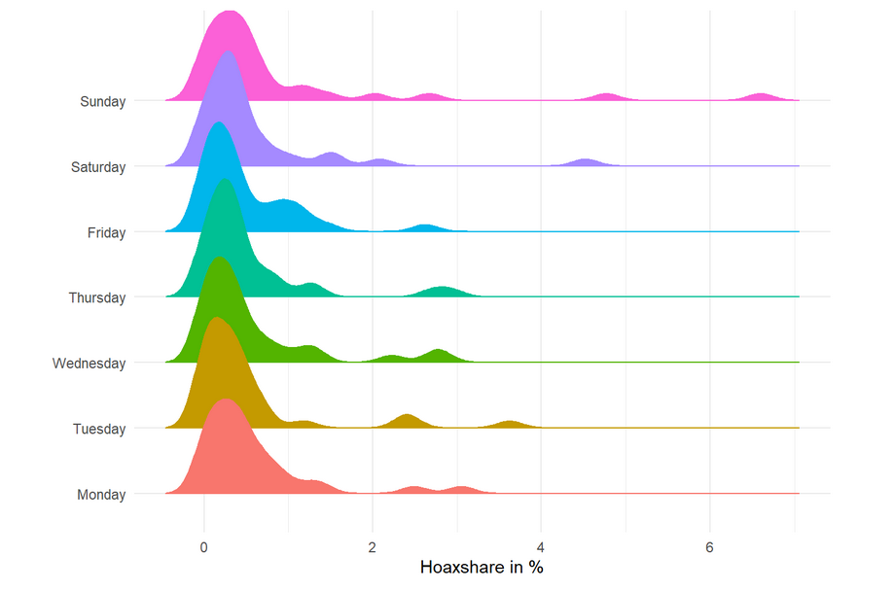
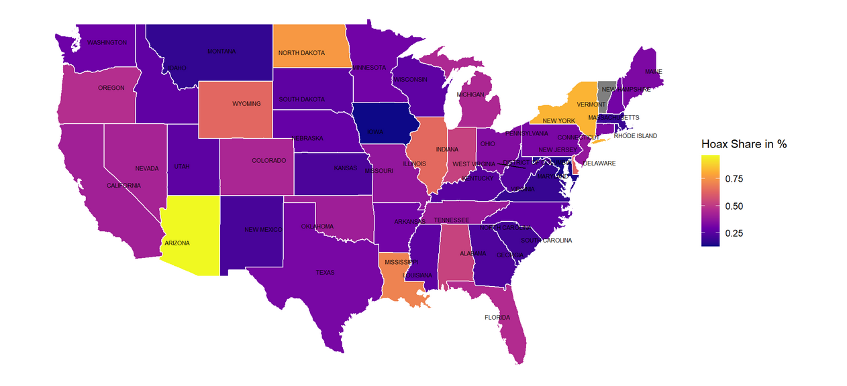
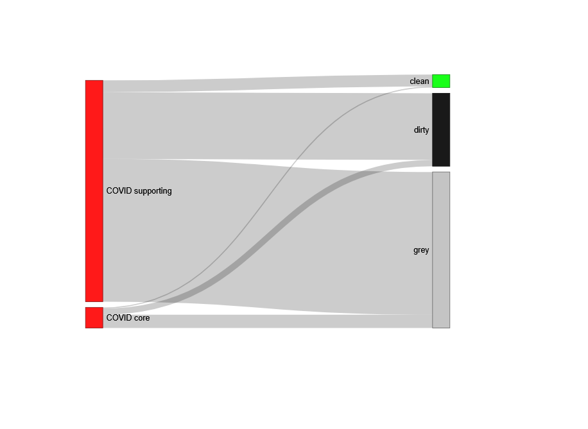
More visions (check here)
Time Series
Bar chart
Histogram
Density histogram
Density Plot
Map
Integrating javascript

Slide 14

Takeaways
R is great for doing visualisations
Have a go yourself:
Find some data
Make a nice diagram with R Markdown
Tell some story with it (with R Markdown)
Post to RPubs as well as the Datathon Visualisation Challenge 2021
To find data you can have a look at the Data Resources Channel
If you are on twitter you can share @datastorieshub

